Slide 1
Cryptography Tutorial
Prepared by
Dr. T. Sree Sharmila

Slide 2
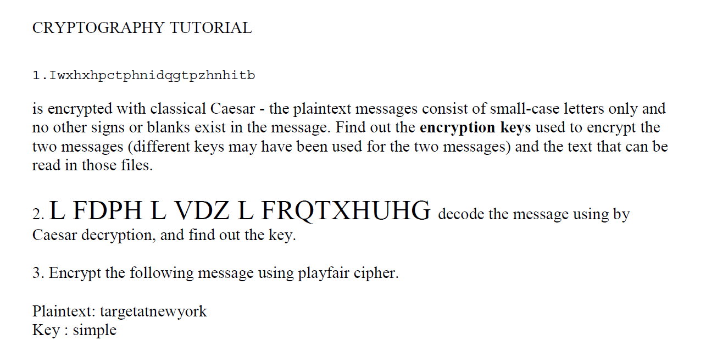

Slide 3
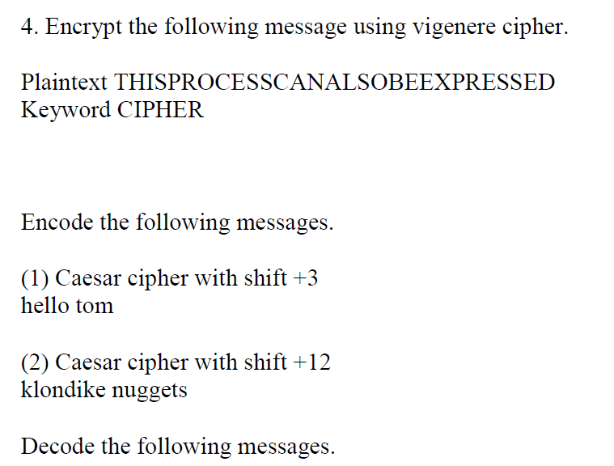

Slide 4
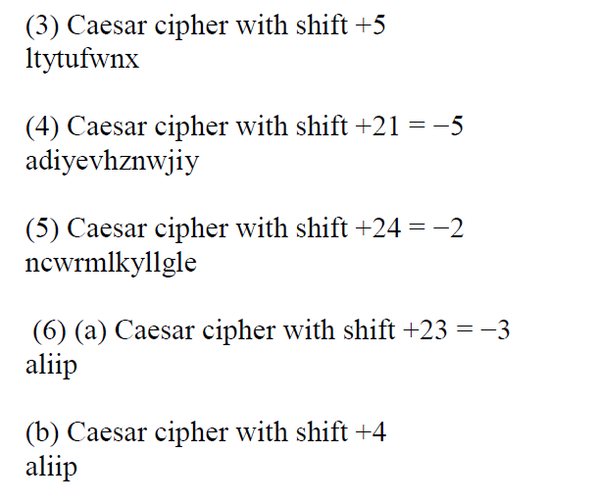

Slide 5
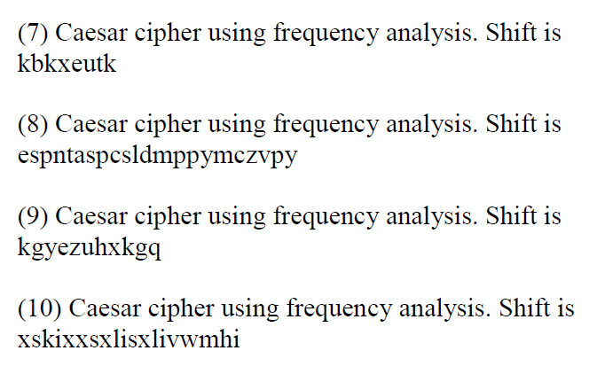

Slide 6
